Slide 1
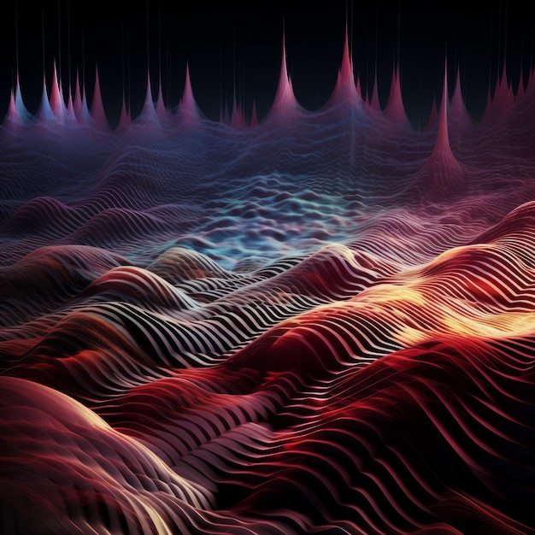
Introduction to Signals in Mechatronics
Akbar Q

Slide 2
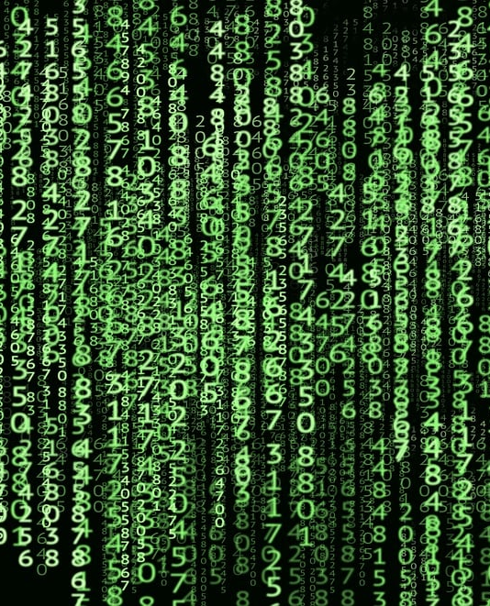
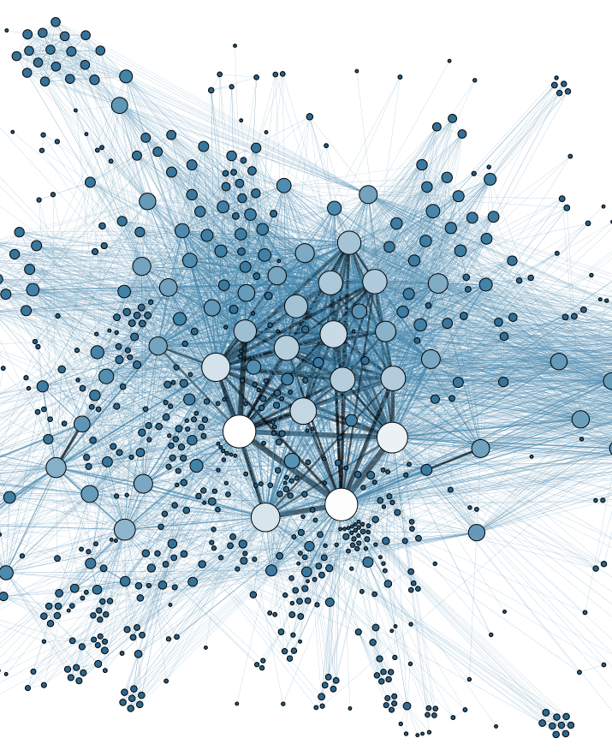
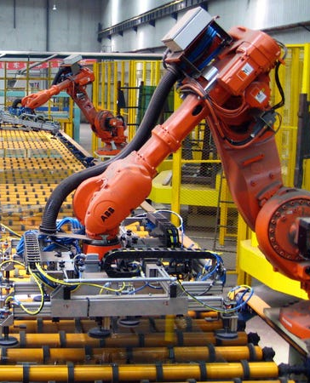
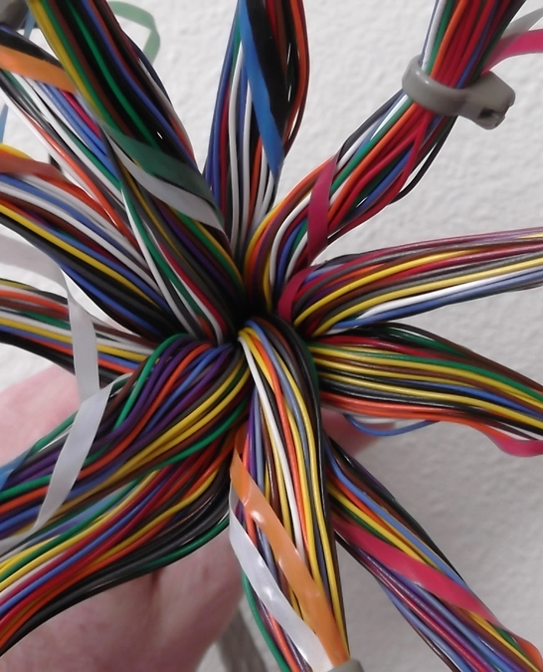
Introduction
Signals are the backbone of mechatronic systems. They facilitate communication between components such as sensors, actuators, and controllers. Understanding signals is crucial for designing and troubleshooting these systems.

Slide 3
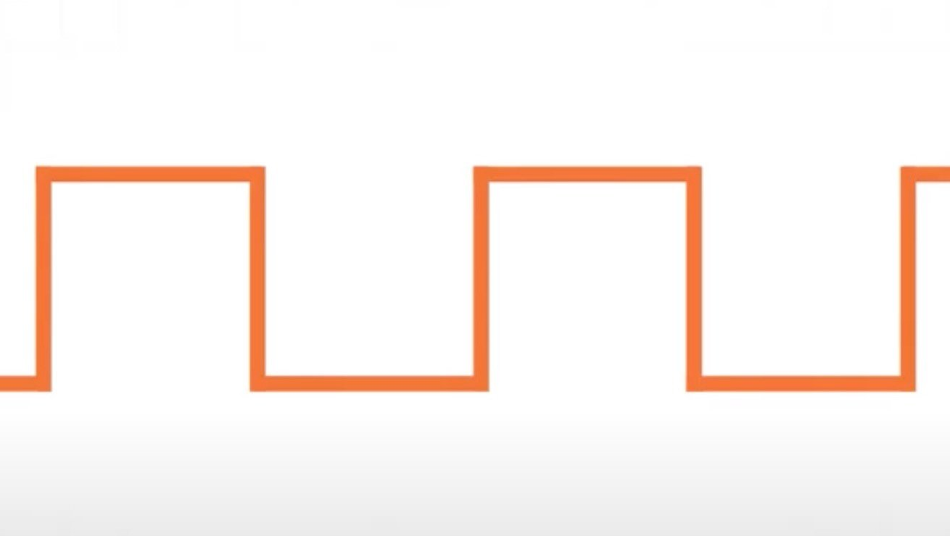
Basic Types
Analog Signals
Digital Signals

Slide 4
Primary Classification
ANALOG
DIGITAL
- Continuous in nature.
- Represented by varying values over time (e.g., temperature readings).
- Examples: Voltage, current, pressure.
- Discrete and binary in nature (0s and 1s).
- Used for precise control and communication.
- Examples: Data transmission, microcontroller inputs/outputs.

Slide 5
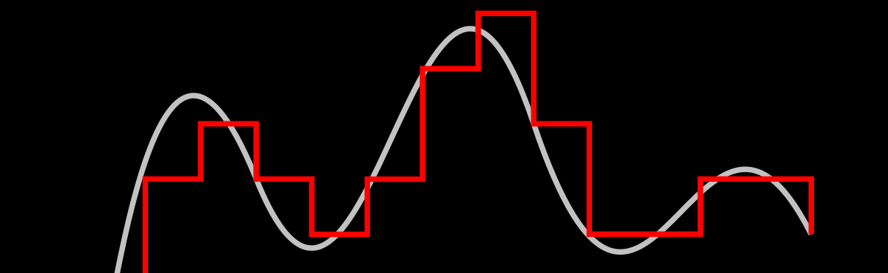
Digital Does NOT Mean 2 Levels
It can have more levels, just have to be discrete levels

Slide 6

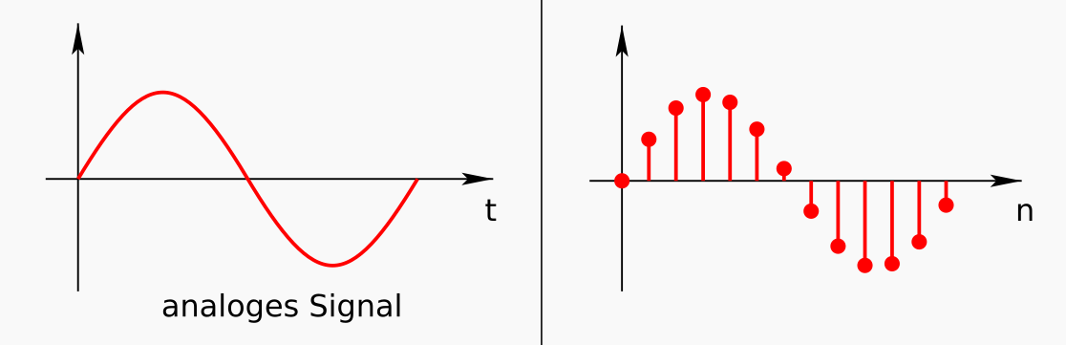
Discrete Levels

Slide 7
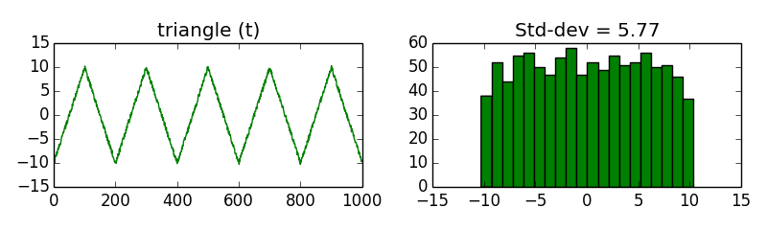
Week 1 Activity 1
Find Out 5 Signals and Identify if they are Digital or Analog

Slide 8
Analog Signals
Advantages
Disadvantages
- Simplicity: Easy to generate and detect.
- Precision: Can represent a wide range of values with high resolution.
- Existing Infrastructure: Widespread use in legacy systems.
- Noise Susceptibility: Vulnerable to electromagnetic interference (EMI).
- Drift and Offset: Signal degradation over time or distance.
Complexity in Processing: Requires additional circuitry for accurate measurement.
Complexity in Generation: Requires additional circuitry for accurate timing.

Slide 9
Generating an Analog Signal using PWM

Slide 10
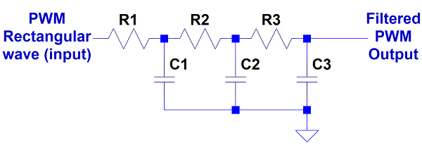
Generating an Analog Signal using PWM - Filter Circuit

Slide 11
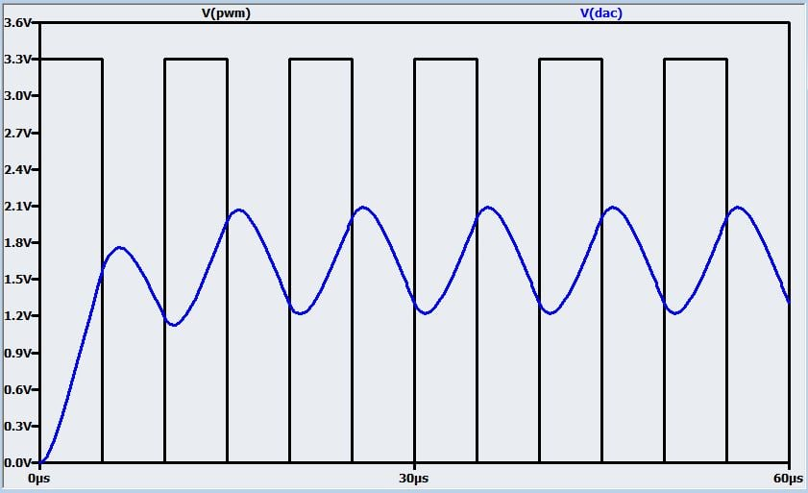
Result of Filtered PWM Signal

Slide 12
Result of Filtered PWM Signal Visualized

Slide 13
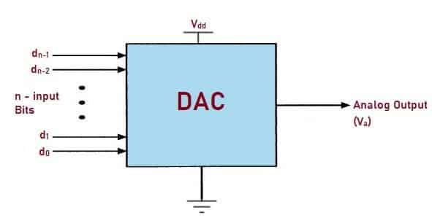
Generating an Analog Signal via a DAC

Slide 14
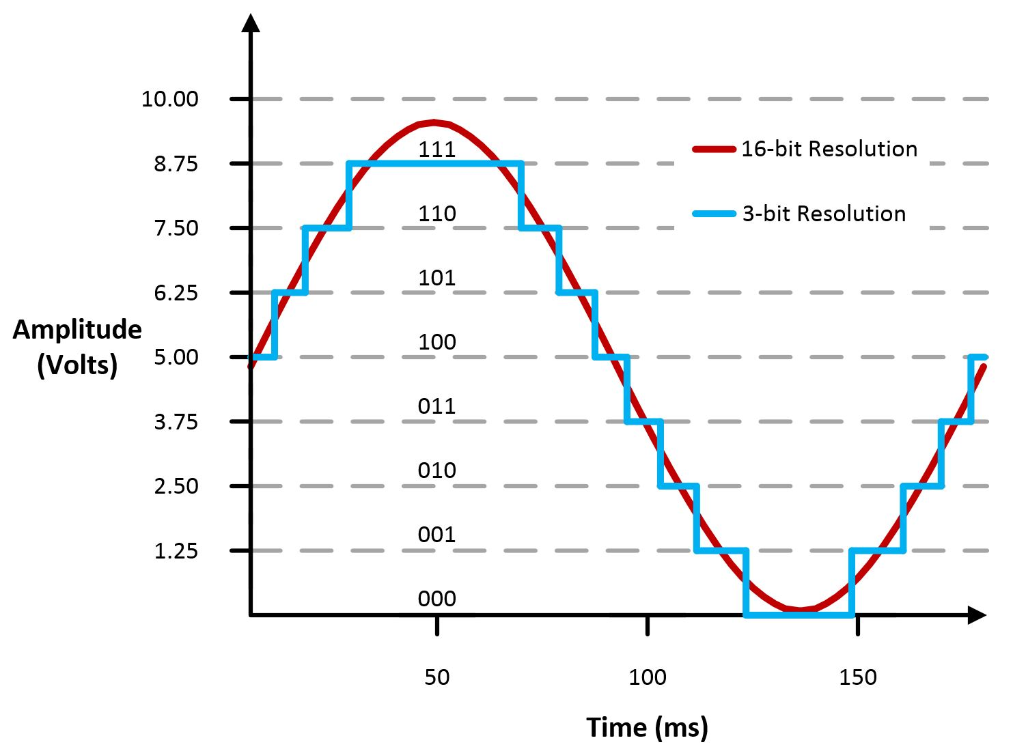
Generating an Analog Signal via a DAC

Slide 15
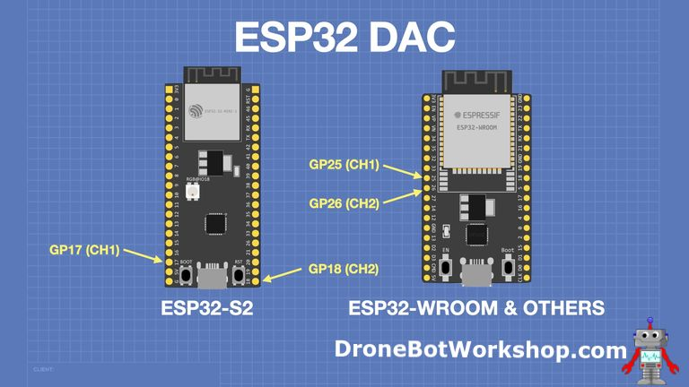
Many Controllers Come with DACs

Slide 16
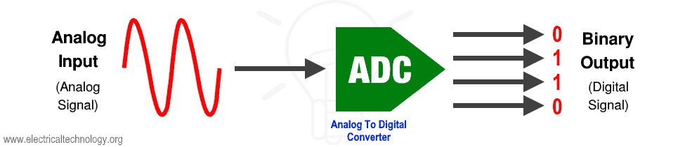
Measuring the Analog Signals

Slide 17
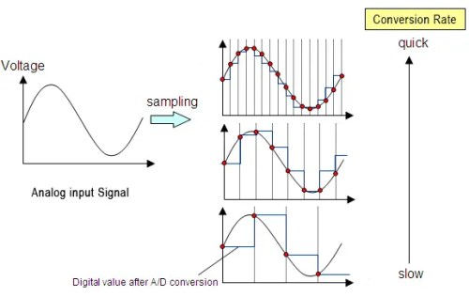
Analog Sampling Precision

Slide 18
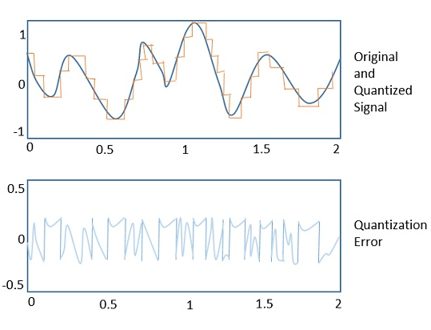
Error Introduced from Quantization

Slide 19
Interpolation is Done to Fill in Gaps

Slide 20
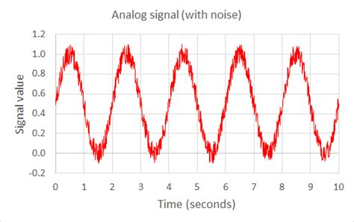
Noise Pickup can Cause Bad Readings

Slide 21
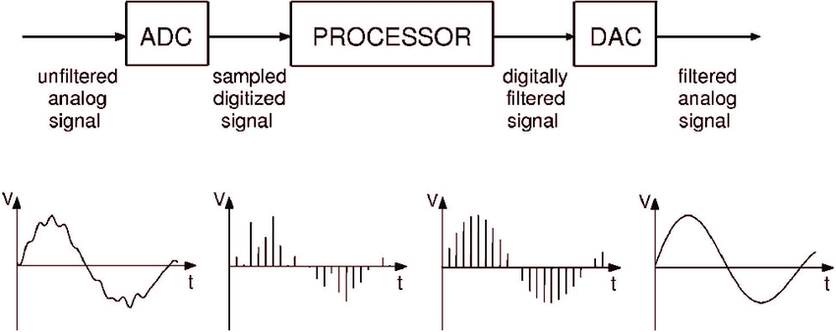
Controllers will have to Clean Up Signals

Slide 22
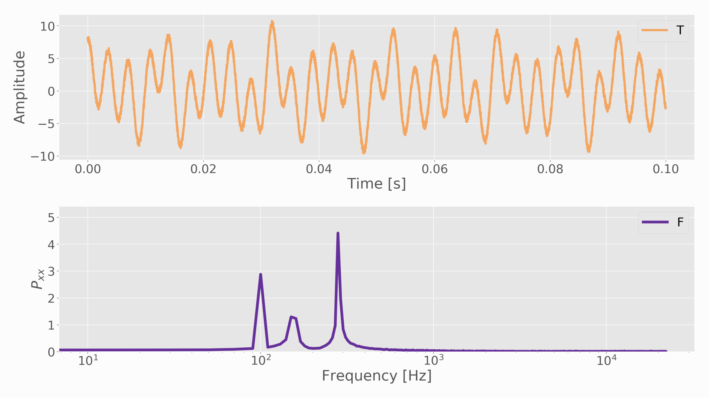
FFT Can Reveal Noise/Signal Content

Slide 23
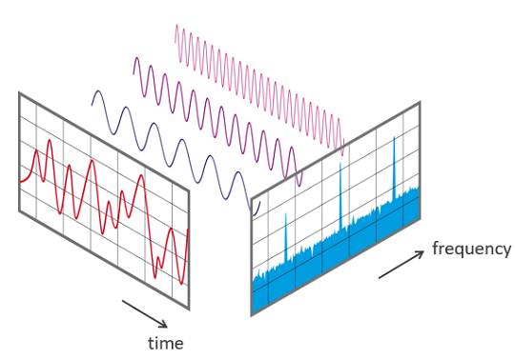
FFT Splits the Frequency Content

Slide 24
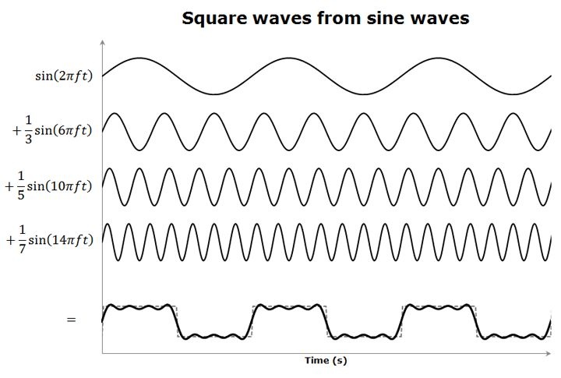
Every Signal Can be Broken Down

Slide 25
Digital Signals
Advantages
Disadvantages
- Immunity to Noise: Resistant to EMI, ensuring reliable communication.
- Ease of Data Handling: Facilitates data processing and storage.
- Precision: Reduces errors through binary representation.
- Limited Resolution: Limited by the number of bits used to represent values.
- Latency Issues: Delays can occur due to processing requirements.
- EMI: High Data Rates can Cause Excessive EMI emissions

Slide 26
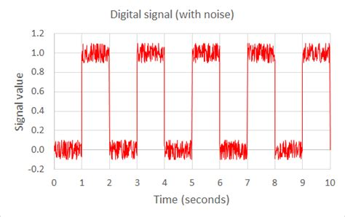
Digital Signals are Noise Resistant

Slide 27
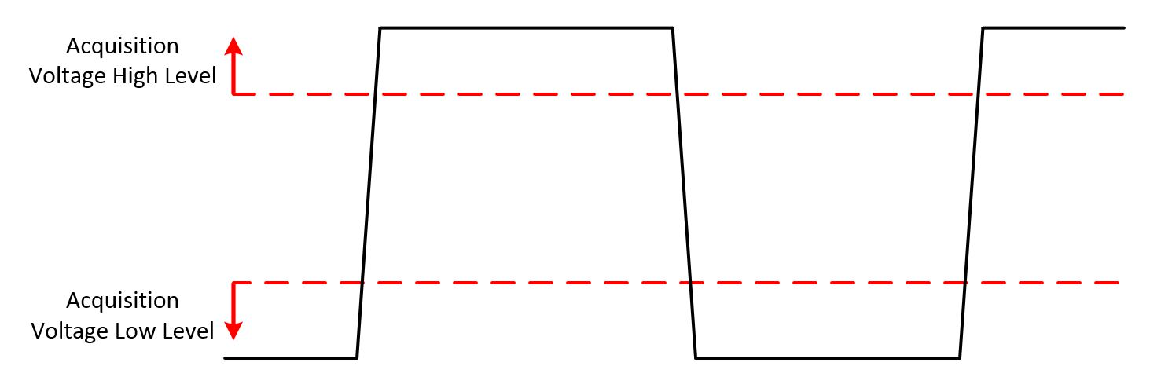
As Long as It is With-In Limits

Slide 28
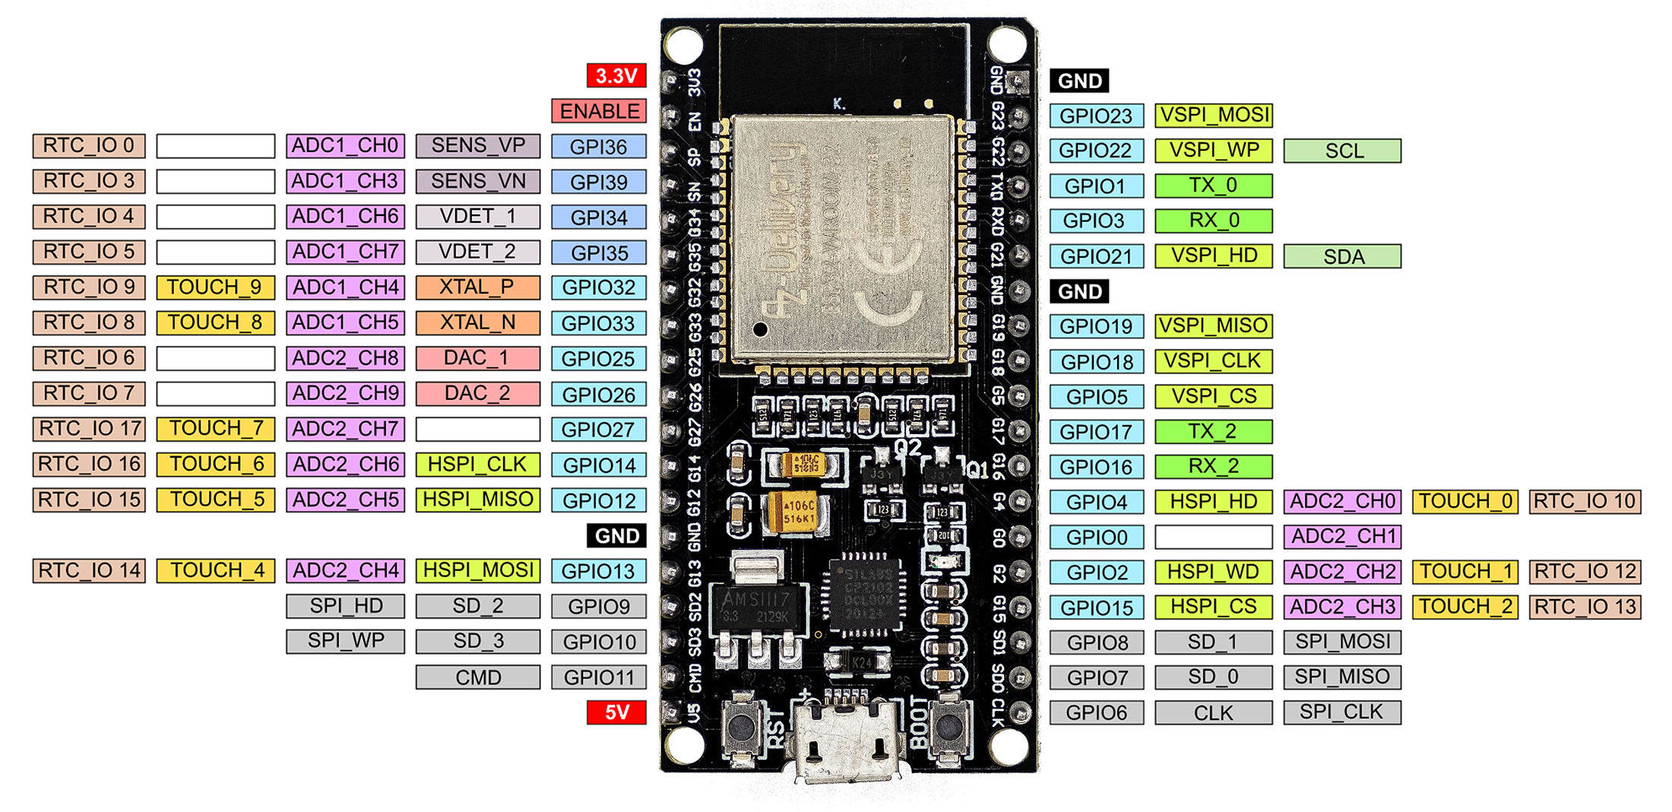
Not Everything can Process Analog Signals but (almost) everything can Digital

Slide 29
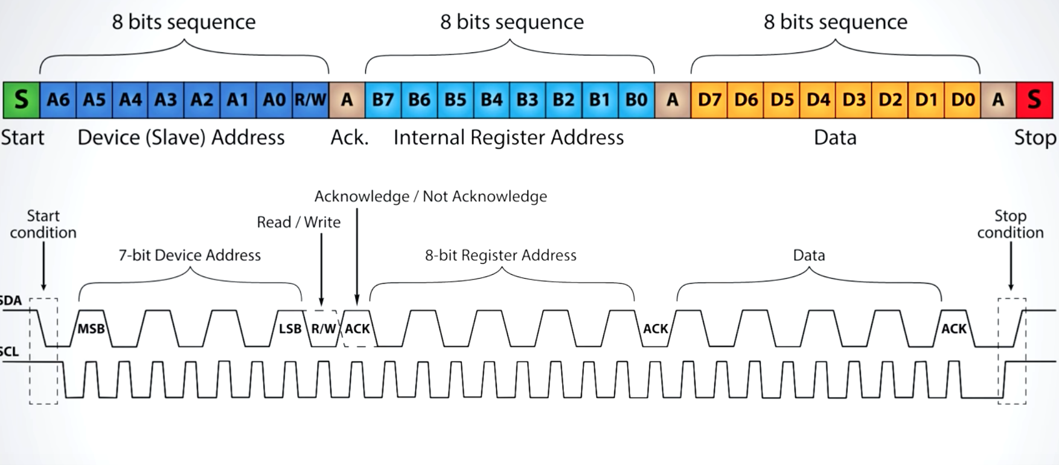
Typical Digital Data Used for Communication

Slide 30
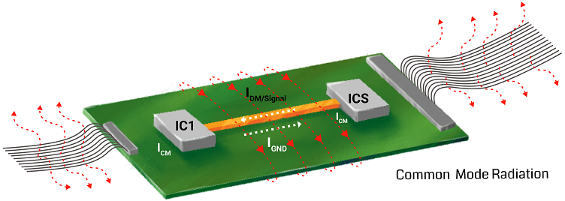
Everything is an Antenna if the Frequency is High Enough

Slide 31
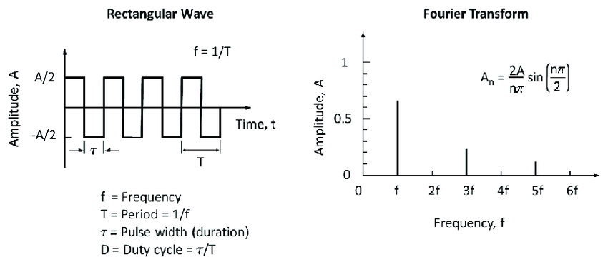
A Perfect Square Wave has Infinite Number of Harmonics – Thus It will Radiate Energy Always

Slide 32
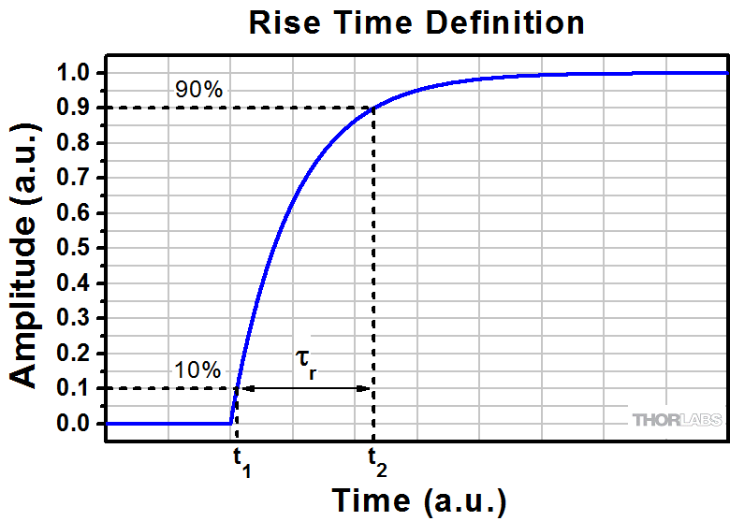
Directly Depends on Rise Time

Slide 33
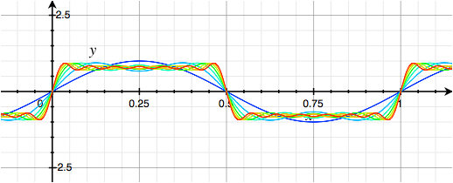
Varying the Number of Harmonics

Slide 34
Varying the Number of Harmonics

Slide 35
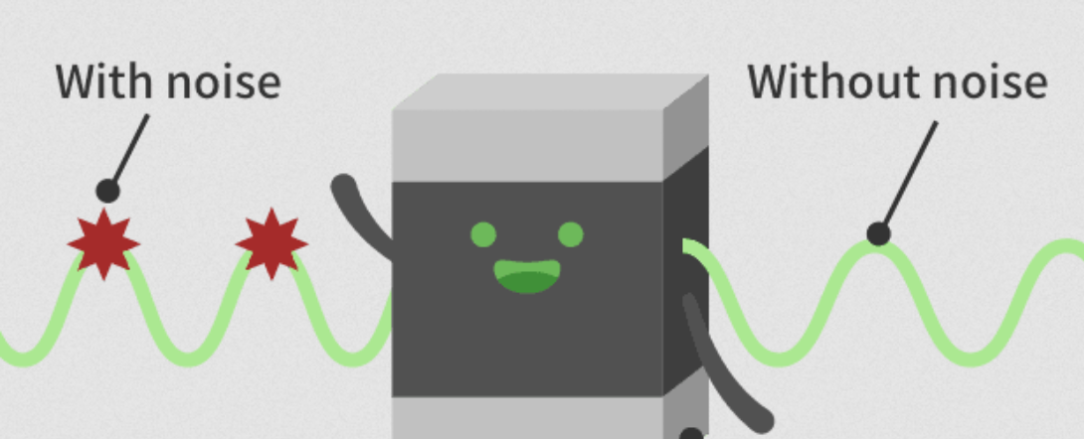
Inductors and Capacitors Used to Control Edge Rate and Noise

Slide 36
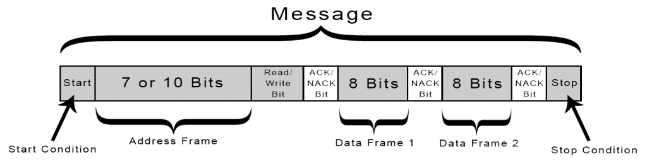
Week 1 Activity 2
Find Out the Speed of 2 Common Communication Protocols

Slide 37

The End of Week 1

Slide 38
Chart

Slide 39
Table
 | Category 1 | Category 2 | Category 3 | Category 4
Item 1 | 4.5 | 2.3 | 1.7 | 5
Item 2 | 3.2 | 5.1 | 4.4 | 3
Item 3 | 2.1 | 1.7 | 2.5 | 2.8
Item 4 | 4.5 | 2.2 | 1.7 | 7

Slide 40




Team
Name
Name
Name
Name
Title
Title
Title
Title

Slide 41
Timeline
Title
To start a presentation, go to the Slide Show tab, and select From Beginning.
Title
To display Presenter view, in Slide Show view, on the control bar at the bottom left select the three dots, and then Show Presenter View.
Title
During your presentation, the speaker notes are visible on your monitor, but aren't visible to the audience.
Title
Title
If you can’t see the Notes pane or it is completely minimised, click Notes on the task bar across the bottom of the PowerPoint window.
The Notes pane is a box that appears below each slide. Tap it to add notes.

Slide 42
Content
Subtitle
Subtitle
Add text, images, art, and videos.
Add transitions, animations, and motion.
Save to OneDrive, to get to your presentations from your computer, tablet, or phone.
Open the Design Ideas pane for instant slide makeovers.
When we have design ideas, we’ll show them to you right there.

Slide 43
Content 2
Subtitle
subtitle
subtitle
Add text, images, art, and videos.
Add transitions, animations, and motion.
Save to OneDrive, to get to your presentations from your computer, tablet, or phone.
Open the Design Ideas pane for instant slide makeovers.
When we have design ideas, we’ll show them to you right there.
Add text, images, art, and videos.
Add transitions, animations, and motion.
Save to OneDrive, to get to your presentations from your computer, tablet, or phone.
Open the Design Ideas pane for instant slide makeovers.
When we have design ideas, we’ll show them to you right there.
Add text, images, art, and videos.
Add transitions, animations, and motion.
Save to OneDrive, to get to your presentations from your computer, tablet, or phone.
Open the Design Ideas pane for instant slide makeovers.
When we have design ideas, we’ll show them to you right there.

Slide 44

Summary
With PowerPoint, you can create presentations and share your work with others, wherever they are. Type the text you want here to get started. You can also add images, art, and videos on this template. Save to OneDrive and access your presentations from your computer, tablet, or phone.

Slide 45


Thank You
Presenter name
Email address
Website address

